Slide 1
Intro to PHP at Winthrop
CSCI 297 Scripting Languages
Day One

Slide 2
PHP
Server-Side scripting language
  interpreted, not compiled
PHP code is embedded in HTML
PHP code is run on the server machine by the web server program when someone requests the file
PHP's output is HTML
PHP is Open Source

Slide 3
MySQL
relational database management system
server based
allows multiple users
fast, efficient, robust

Slide 4
JavaScript
client-side programming language
embedded in HTML files
instructs browser to react to particular events, set attributes of HTML elements, etc.
  e.g. popup a new window
  e.g. check a cookie file
  e.g. only submit a form that contains valid entries

Slide 5
Hello World - your PHP code
<html>
<body>
<P>
<center>
<?php
function longdate ($timestamp)
{
return date("l F jS Y", $timestamp);
}
echo "Hello World<P>Today is ";
echo longdate(time());
?>
</body>
hello.php
On Deltona this file must end with .php
not .html

Slide 6
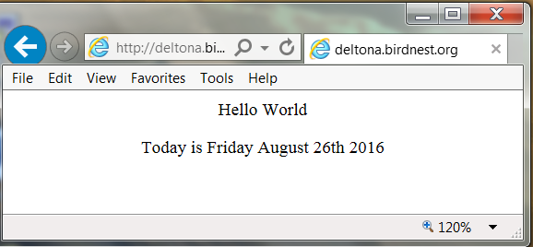
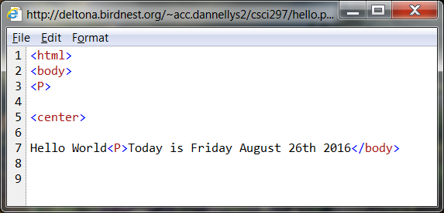
Hello World - what the user sees

Slide 7
Winthrop's Configuration
Winthrop's PHP server for students is deltona.birdnest.org
Your homepage:
  http://deltona.birdnest.org/~acc.yourid/
The deltona web server looks for all web files in your public_html directory.
You can edit your files from any linux box on the Winthrop network.
Your homepage is index.html, not default.htm.

Slide 8
Steps to create your first PHP script
Go to your root directory
    cd
Create a public_html directory, if necessary
    mkdir public_html
Make your root directory and the html directory readable by the web server process (it is run by "nobody", not you).
    chmod a+x .
    chmod a+x public_html
Move to the html directory and create your script file
    cd public_html
    vi hello.php
    chmod a+r hello.php

Slide 9
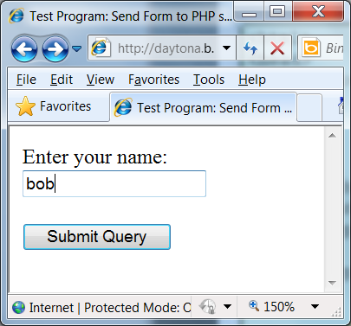
A Better Example
simpleform.html
<html>
<head>
<title>Test Program: Send Form to PHP script</title>
</head>
<Body>
<form method='post' action='simpleformproc.php'>
Enter your name:<br>
<input type='text' name='yourname'>
<P>
<input type='submit'>
</form>
</Body>
</html>

Slide 10
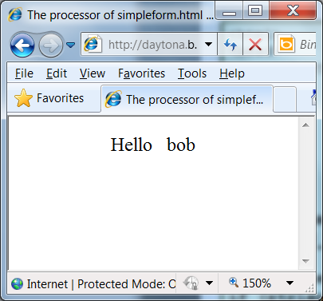
A Better Example
simpleformproc.php
<html>
<head>
<title>The processor of simpleform.html</title>
</head>
<body>
<center>
Hello
&nbsp;
<?php
// get name from form
$name = $_POST['yourname'];
// did they really enter something?
if (strlen($name) == 0)
echo "whoever you are.";
else
echo $name;
?>
</body>
</html>

Slide 11
Your First Homework
Type in my hello.php script and get it to work.
Add comments
  your name
  assignment number
Follow the instructions for emailing your work.
  use the correct subject line

